Slide 1

Khandwa institute of professional studies “LEARNING EDUCATION” Submitted In Partial Fulfillment Of Requirement For The Award Of Degree Of “Bachelor Of Computer Application”
Year 2022-2025
Project Guide Name Submitted By
Mrs. Roopali Agrawal Name: Rohit Rangile
Enrollment No.:AY148134034
Roll No.:
Study Institute Code No.:8134
Submitted to
Makhanlal Chaturvedi National University of journalism and communication, Bhopal

Slide 2

Introduction
Learning education is a comprehensive field that examines how individuals acquire knowledge, skills, and attitudes throughout their lives.
This introduction will explore the foundational concepts of learning education, its significance, and the primary theories that inform educational practices.

Slide 3
System requirement:
Hardware specification Software specification
RAM: 4GB Operating System: Windows 11
Processor: i3 processor or above Web Technology: PHP, HTML, CSS, MySQL, js
Hard-Disk: 1TB Database: MySQL 8.0.31
System Type: 64-bit Operating System. Server: Xampp Server
Design Tool: VS Code
Documentation Tool: MS Word
UML Diagram: LUCID.APP,
online.visual.paradigm.co

Slide 4
Technology used in LEARNING EDUCATION
Language Used:-
1. PHP
2. HTML
3. CSS
4. JS
Database Used:-
1. MYSQL

Slide 5

Future scope of LEARNING EDUCATION :
Integration of advanced technologies.
Personalized learning paths.
Growth of online and blended learning.
Collaborative learning environments.

Slide 6

conclusion
The Learning Education Project Has Provided Valuable Insights Into The Dynamic Nature Of Modern Education, Emphasizing The Necessity For Innovative Teaching Strategies That Engage Students And Cater To Their Diverse Needs.

Slide 7
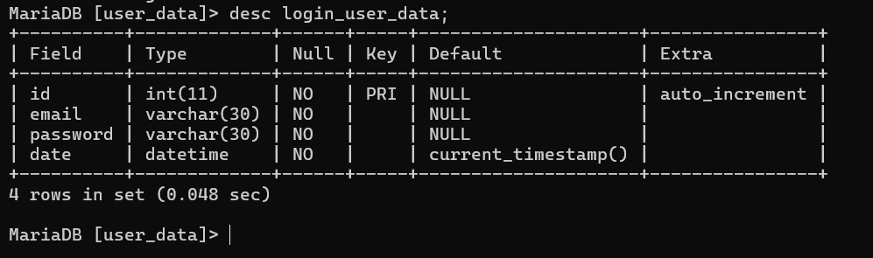
Admin login_user_data :

Slide 8
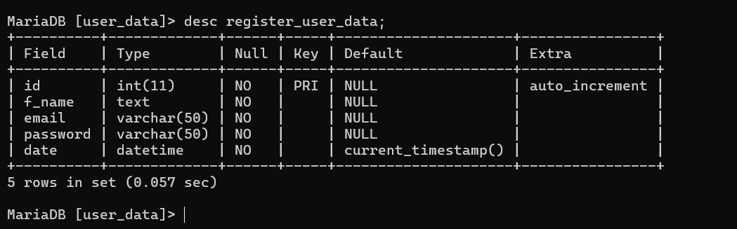
Admin User register_user_data :

Slide 9
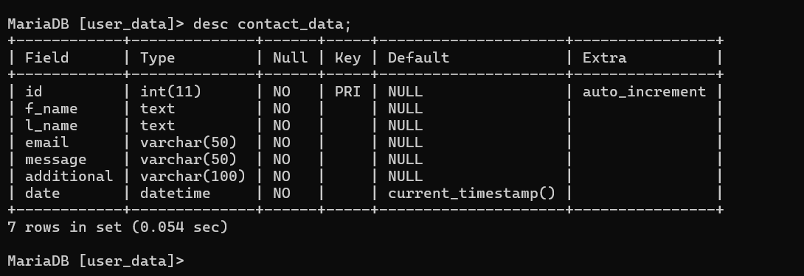
Admin User contact_data :

Slide 10
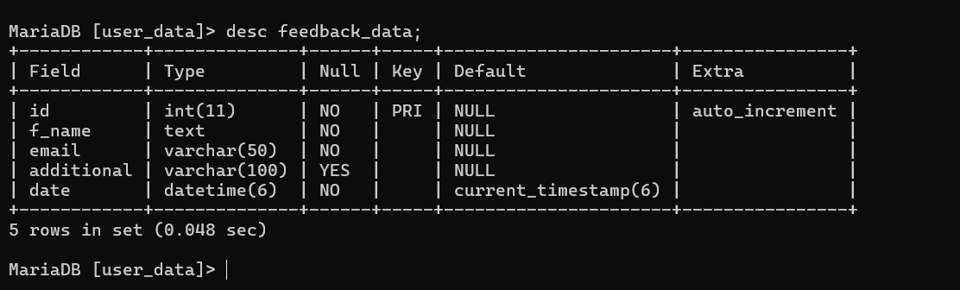
Admin User feedback_data :

Slide 11
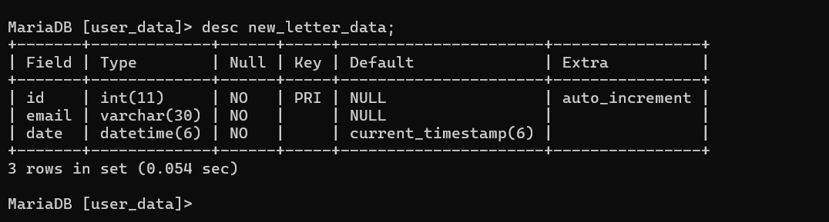
Admin User new_letter_data :

Slide 12
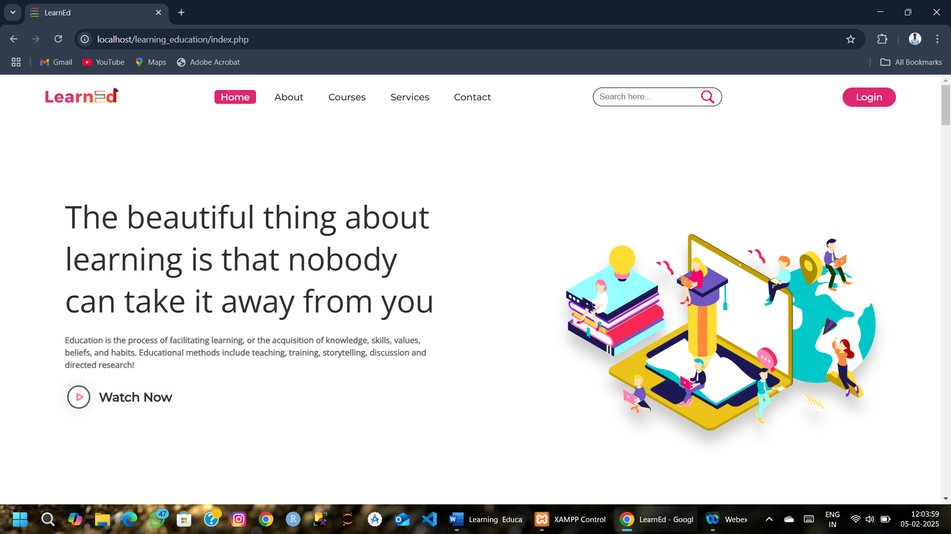
WELCOME TO LEARNING EDUCATION :

Slide 13
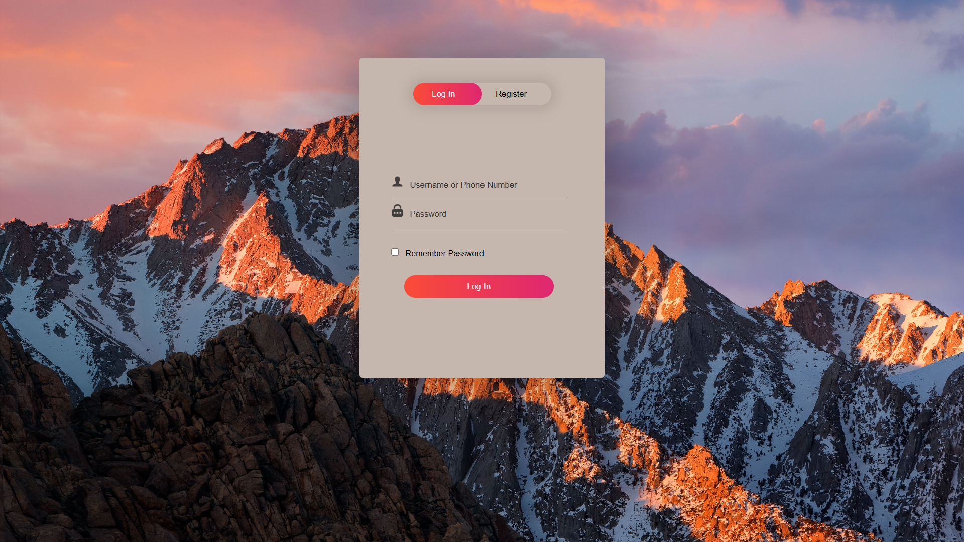
ADMIN LOGIN :

Slide 14
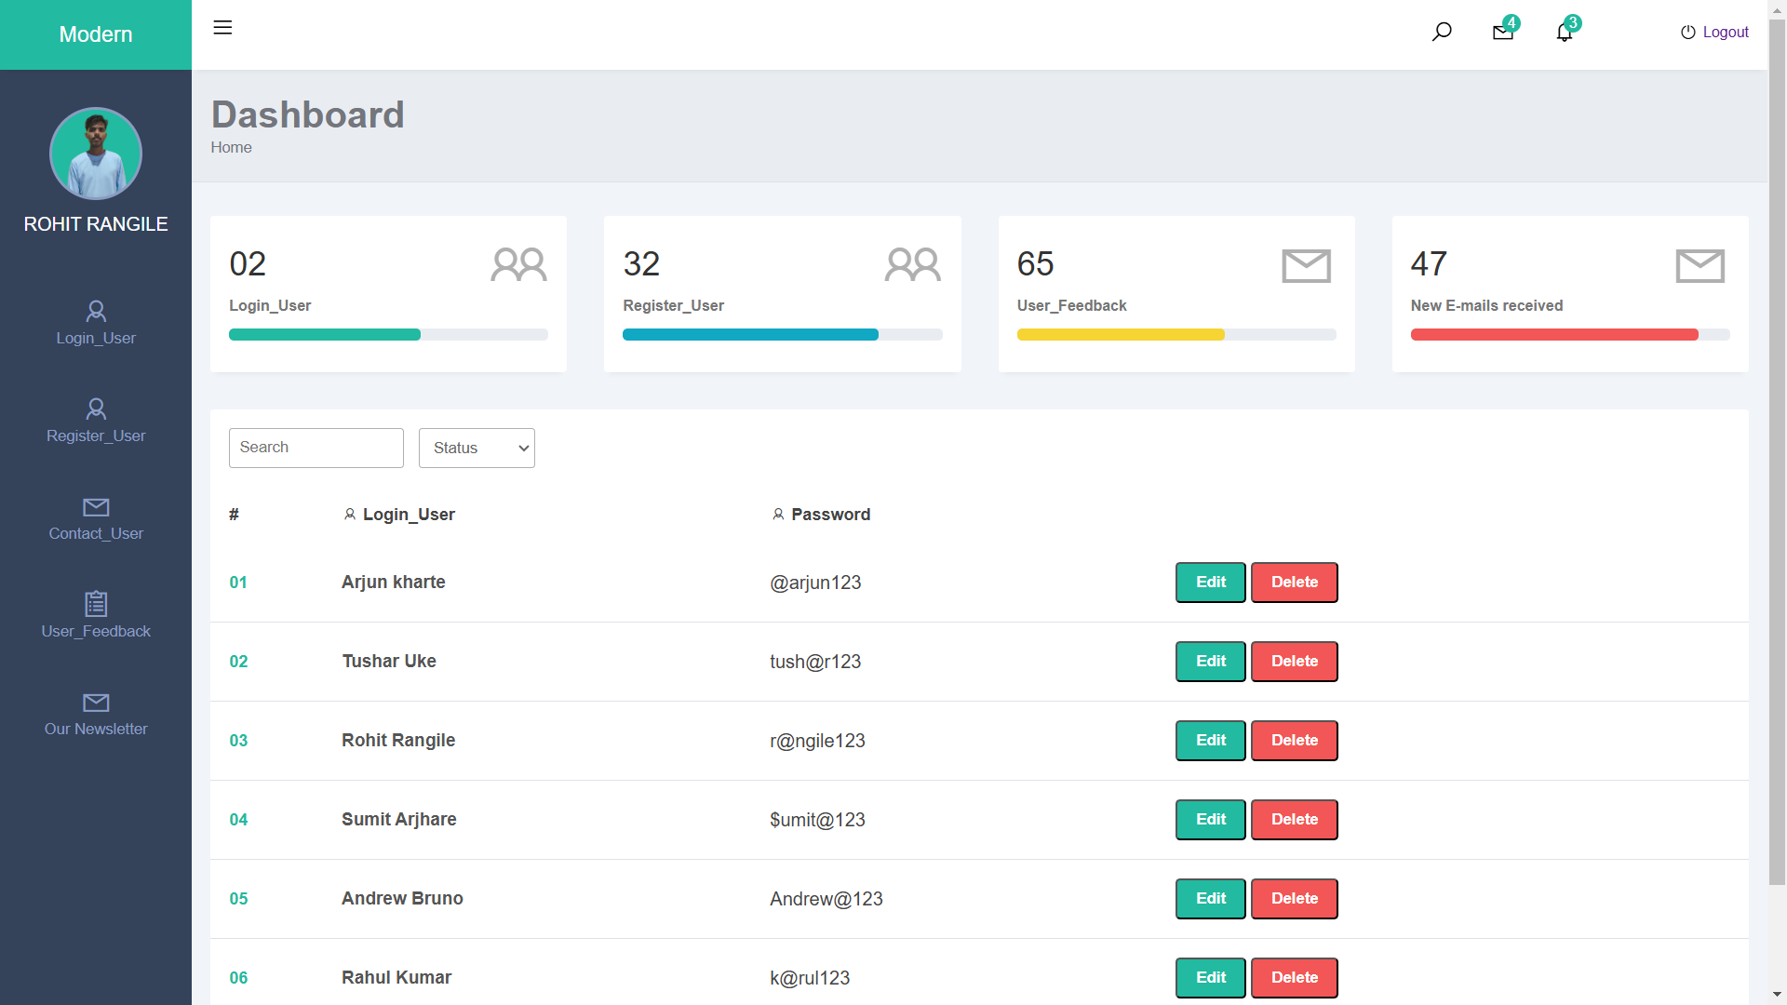
ADMIN DASHBOARD AND USER_LOGIN :

Slide 15
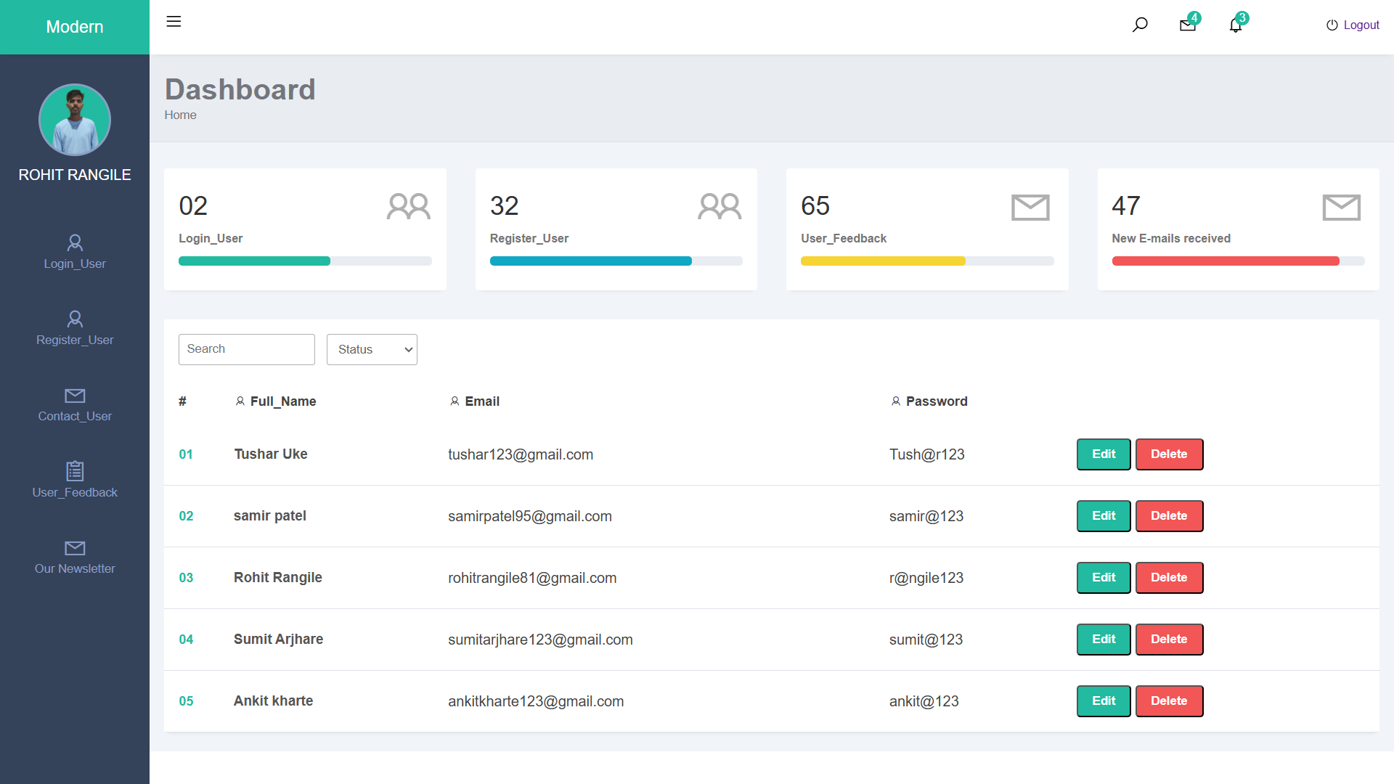
ADMIN REGISTER_USER :

Slide 16
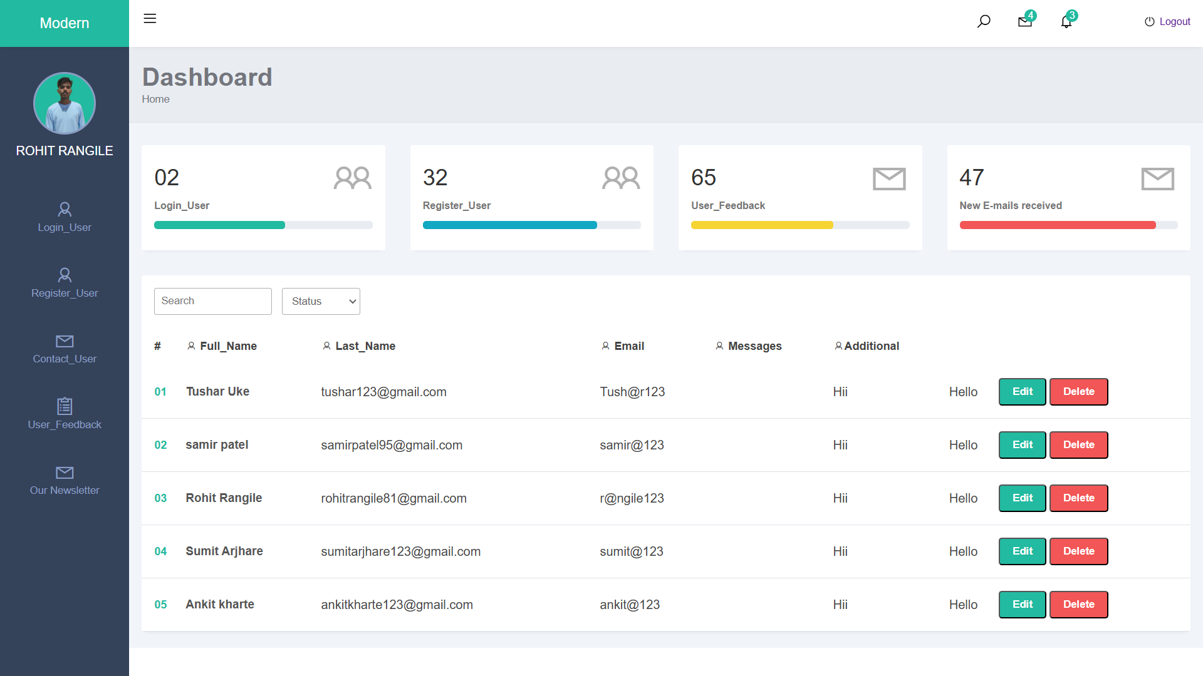
ADMIN CONTACT_USER :

Slide 17
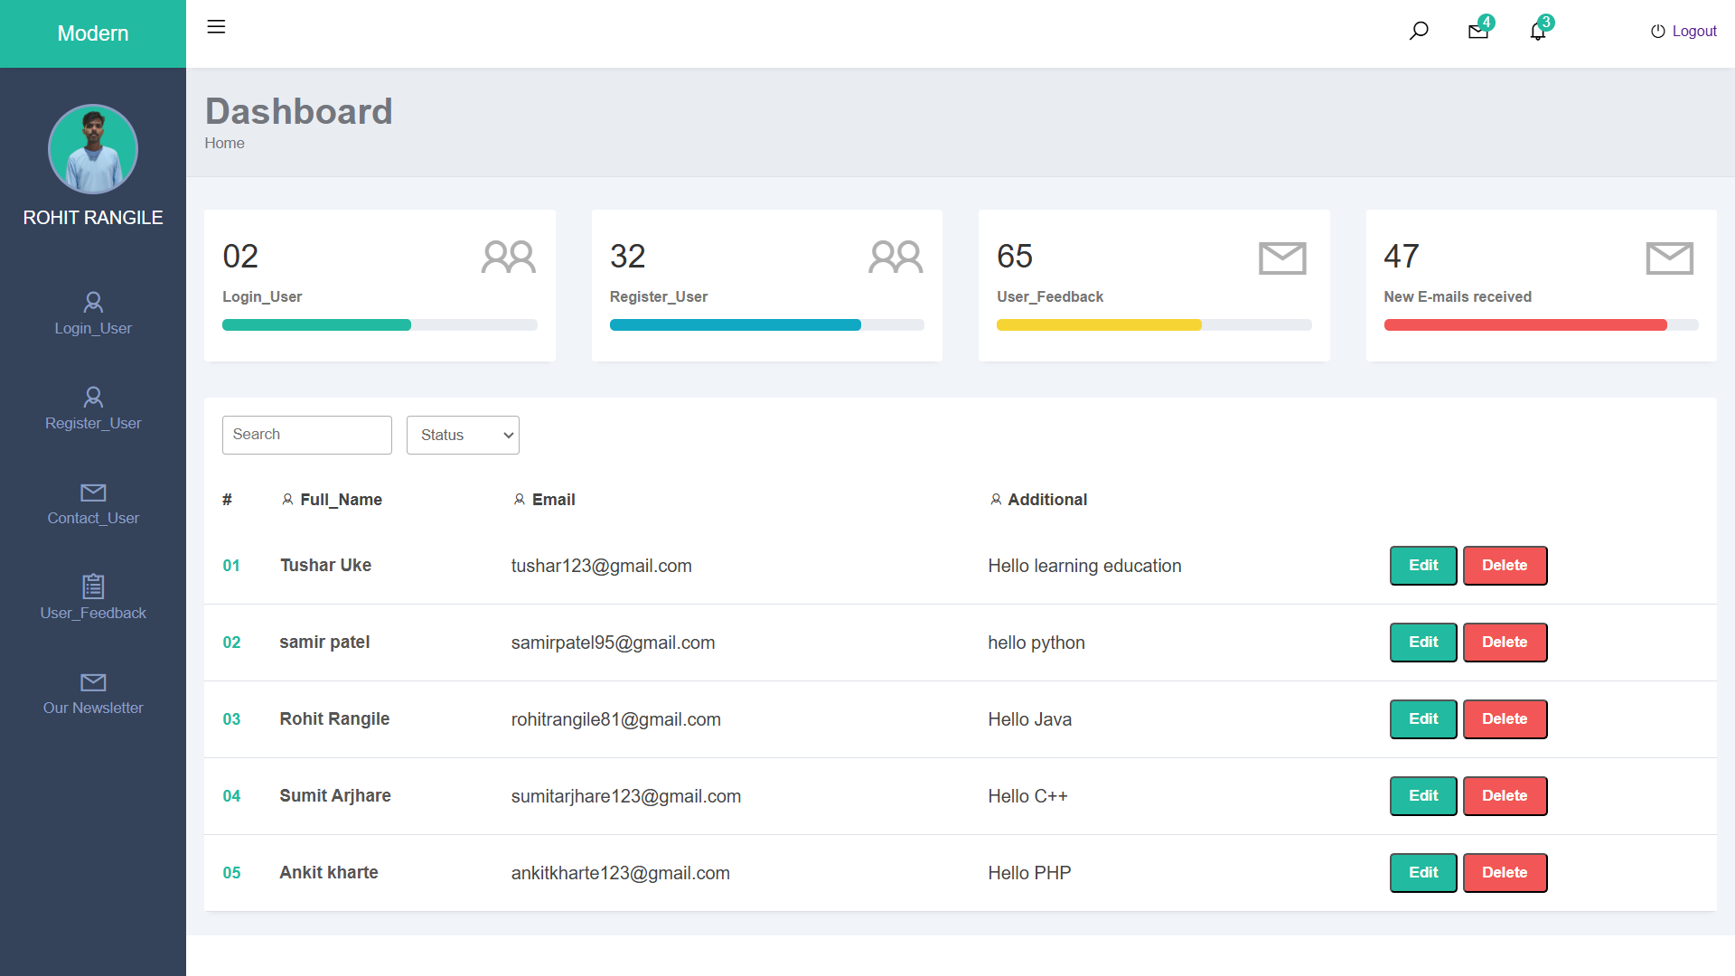
ADMIN USER_FEEDBACK :

Slide 18
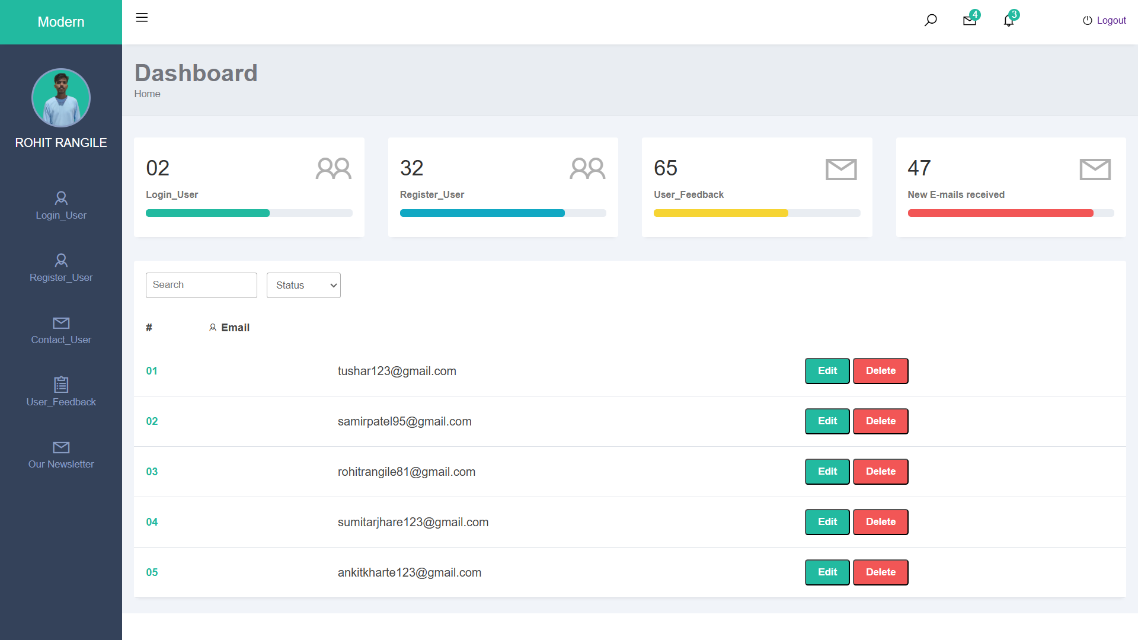
ADMIN OUR NEWSLETTER :

Slide 19
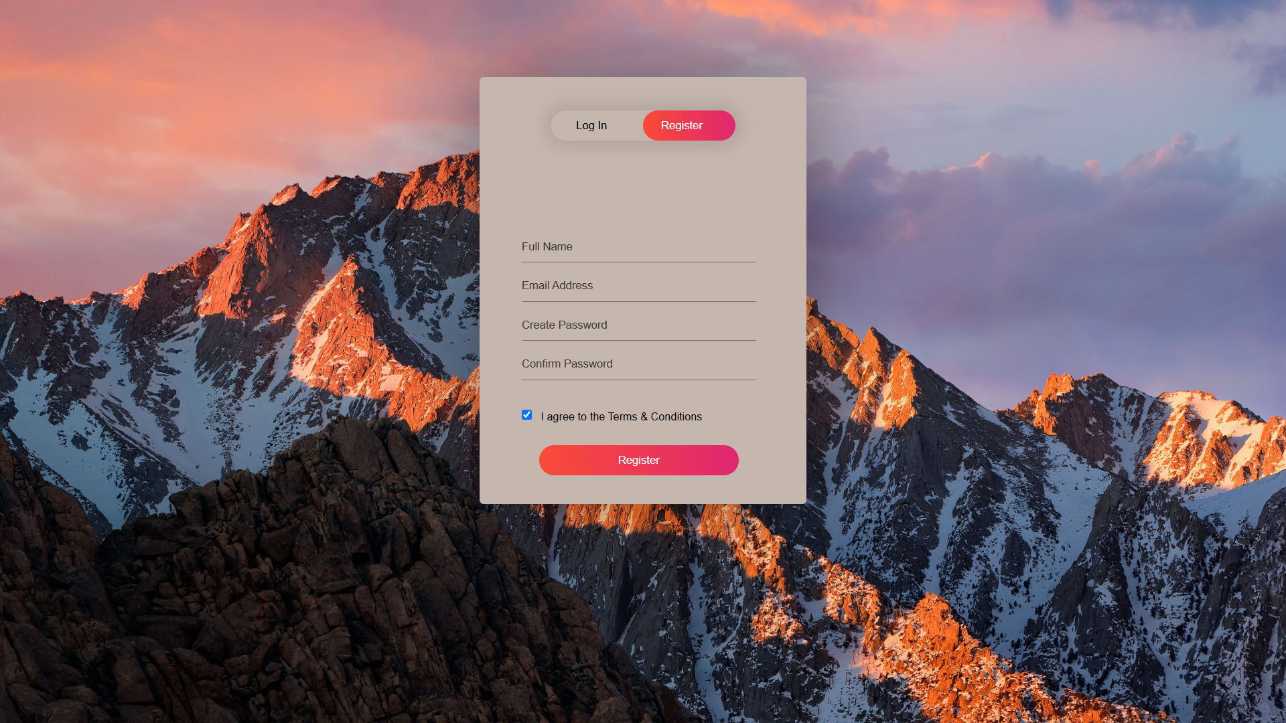
USER REGISTER PAGE :

Slide 20
USER LOGIN PAGE :

Slide 21
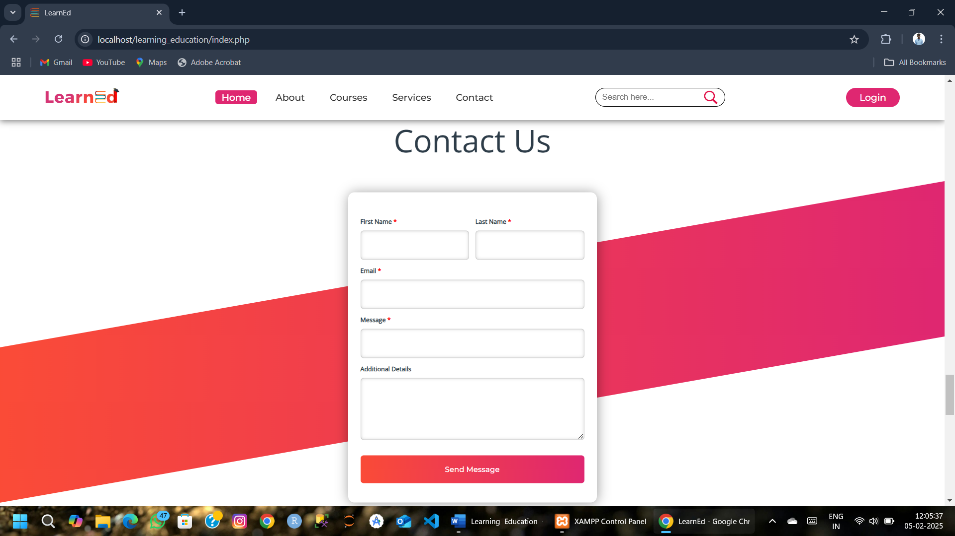
USER CONTACT US :

Slide 22
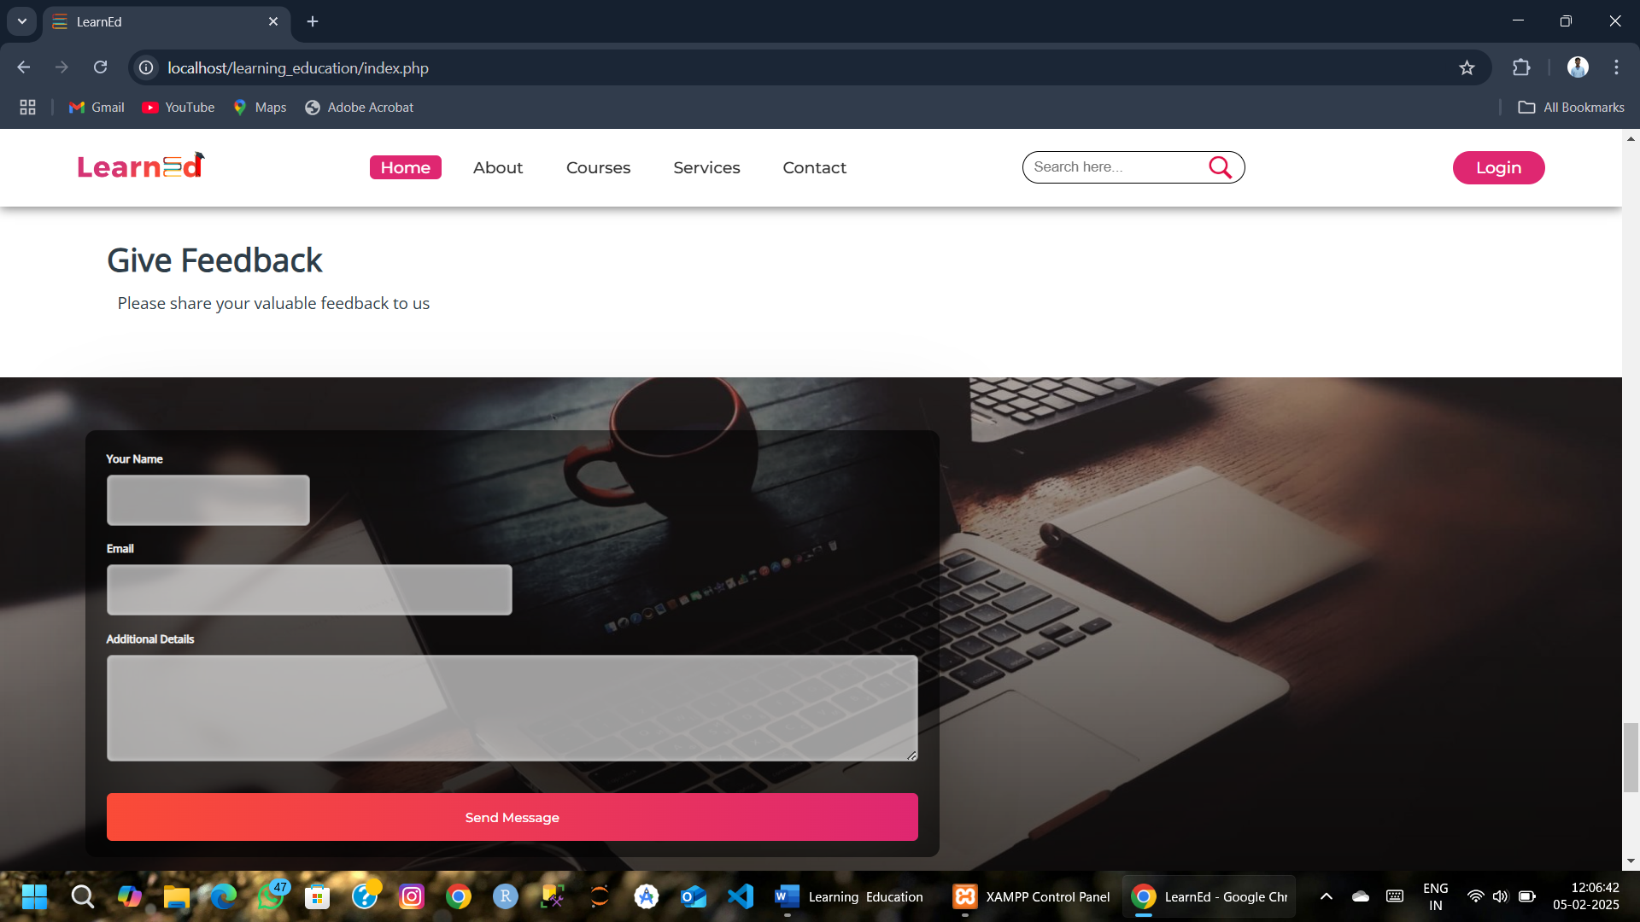
USER FEEDBACK :

Slide 23
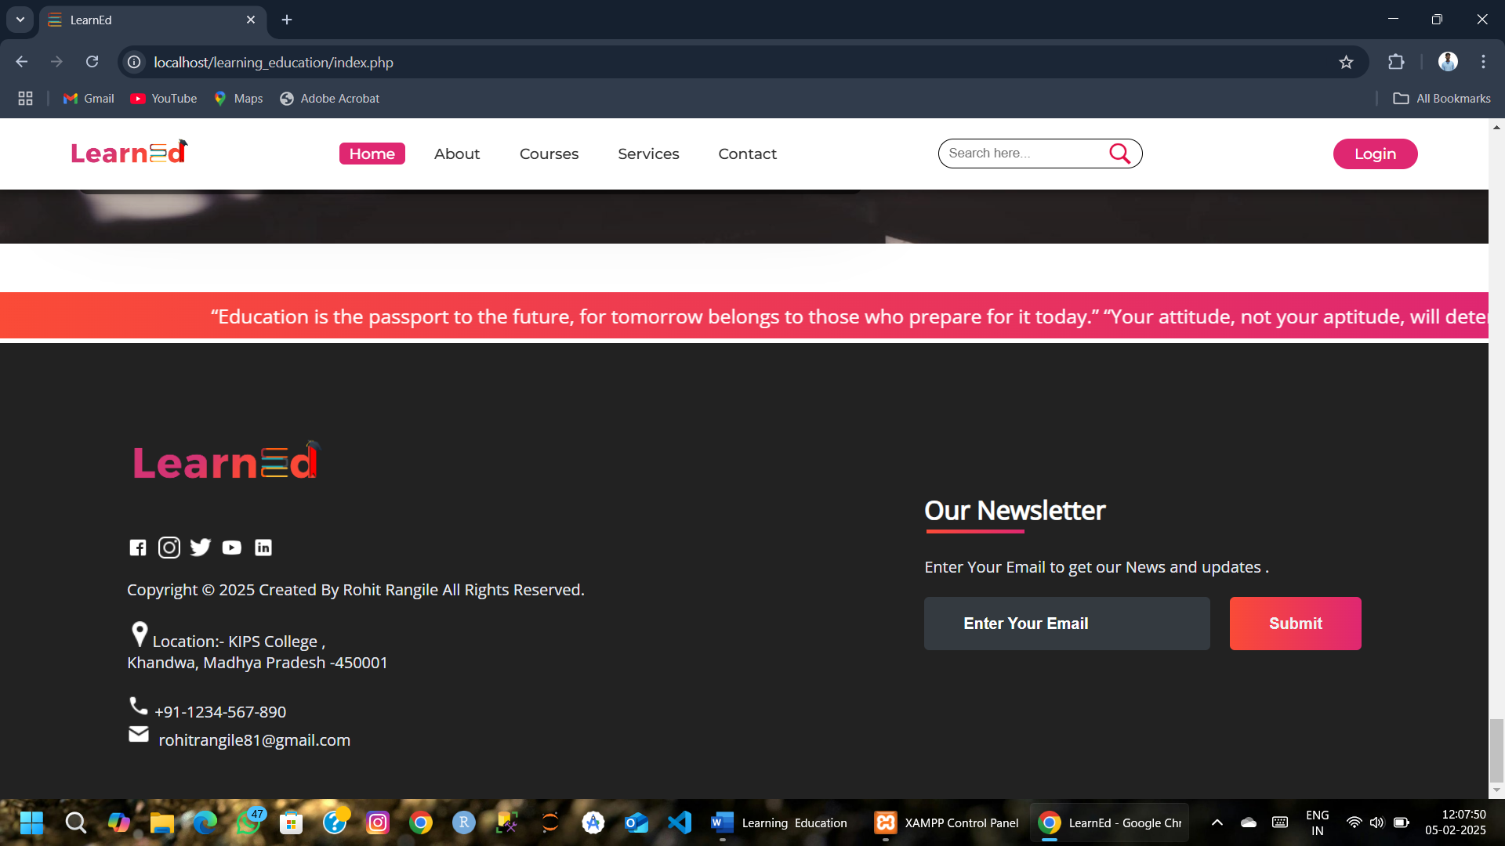
USER OUR NEWSLETTER :

Slide 24


